Slide 1
Key words
Electric field lines
Electric flux
Gauss’s Law
Gaussian surface
Electrostatic shielding
Insulating sphere
Conducting sphere
Conductor
interior
Cube
Cylinder
Cylindrical symmetry
Spherical symmetry
Planar symmetry
Coaxial
Concentric
exterior

Slide 2

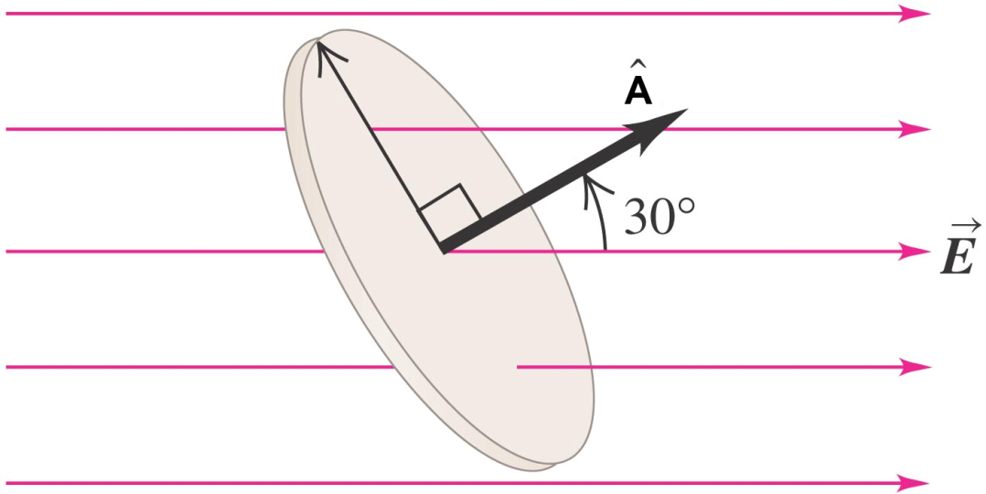



GAUSS’S LAW
electric flux (电通量):
Gauss’ law :

Slide 3
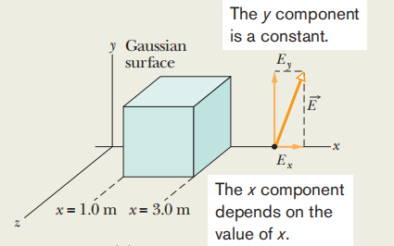
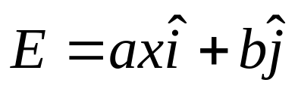
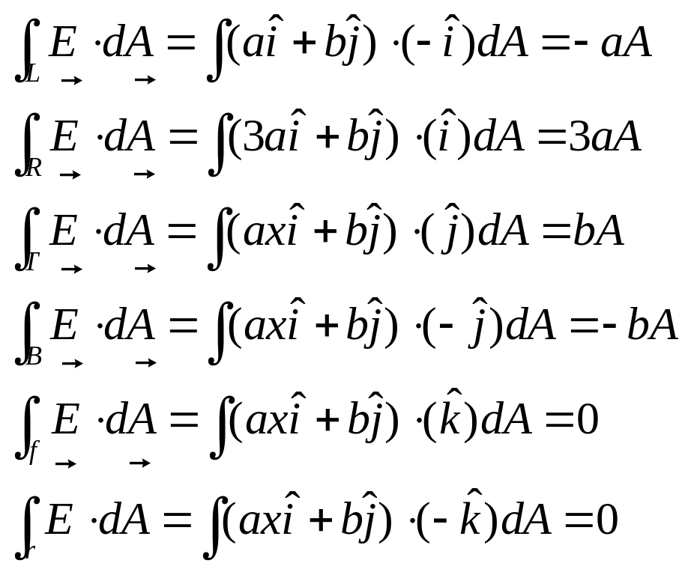
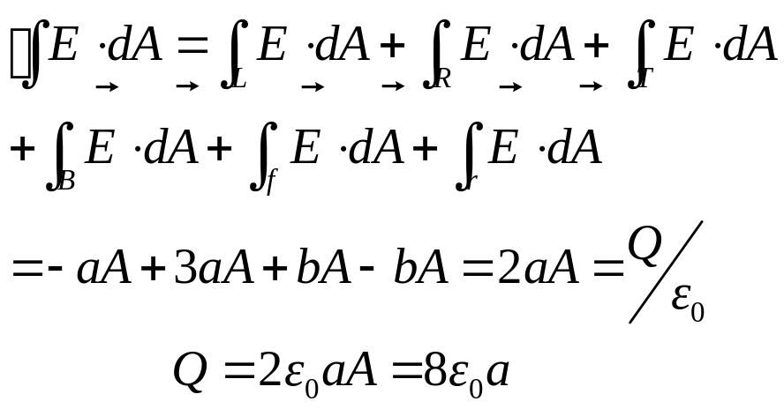
GAUSS’S LAW
A
Net Q inside the cube =?
Cube
Notes:
If here has a charge distribution, and here is an imaginary closed surface, then we can relate the total charge enclosed by the closed surface to the net flux go through that close surface, that is the integration of E created by the whole charge distribution we deal with dot Da over the whole closed surface. Here, keep in mind, E is the field produced by the whole charge distribution, but q enclosed is only the charge enclosed by the closed surface, in this case, only this part of the charge. And here Da is a vector, the magnitude of it is the area of the tiny A and direction is the normal direction pointing from inward to outward.
We can use gauss’s law to calculate the qenc if we know the E filed distribution. And also can calculate the E field if we know the charge distribution having some special symmetry.
Now for what kind of charge distribution we can calculate E by using gauss’s law, and what kinds of Gaussian surface should be chosen?

Slide 4

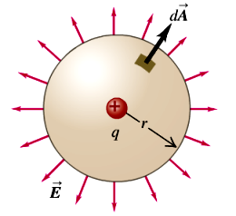
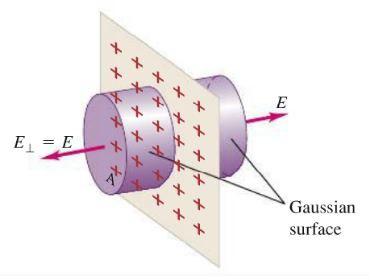
Problem-solving strategy
Select the appropriate closed, imaginary Gaussian surface.
  For spherical symmetry, use a concentric spherical surface
  For cylindrical symmetry, use a coaxial cylindrical surface with flat ends perpendicular to the axis of symmetry
  For planar symmetry, use a cylindrical surface with its flat ends parallel to the plane
+
Notes:
1, for the infinity sheet charge

Slide 5
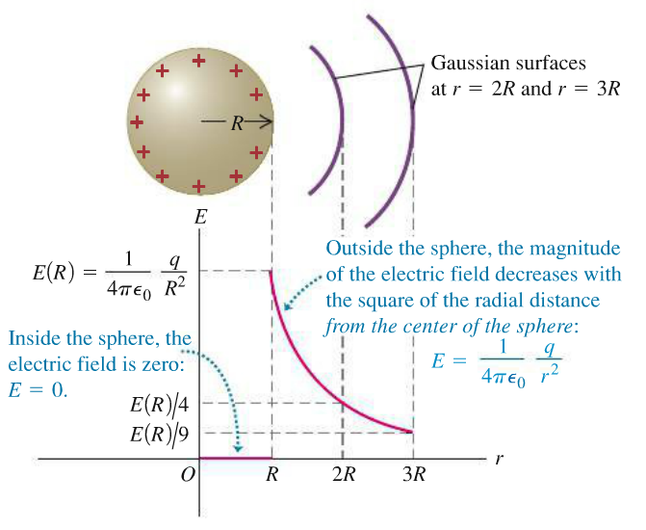
Uniform + charged conducting sphere

Slide 6

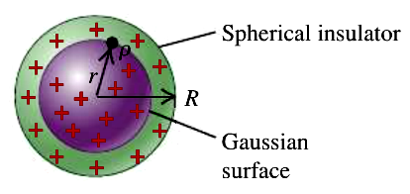





Uniform + charge insulating sphere
Positive charge Q is distributed uniformly
For r < R
E
For r > R
R
r

Slide 7
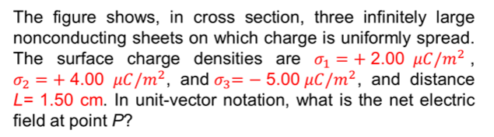
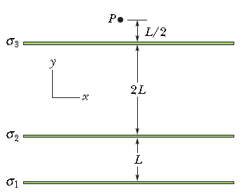
Problem 1

Slide 8
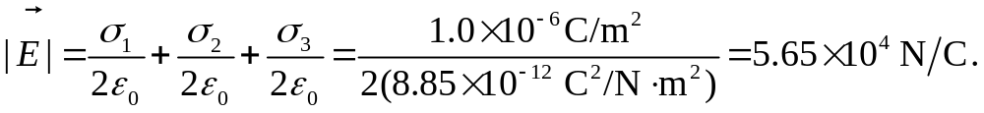

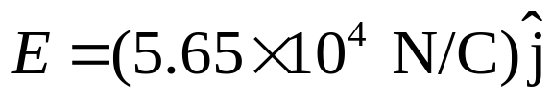
Problem 1
.
,
The fields involved are uniform, the precise location of P is not relevant;
The positively charged sheets contributing upward fields;
The negatively charged sheet contributing a downward field;
The net field is directed upward
In unit-vector notation:

Slide 9
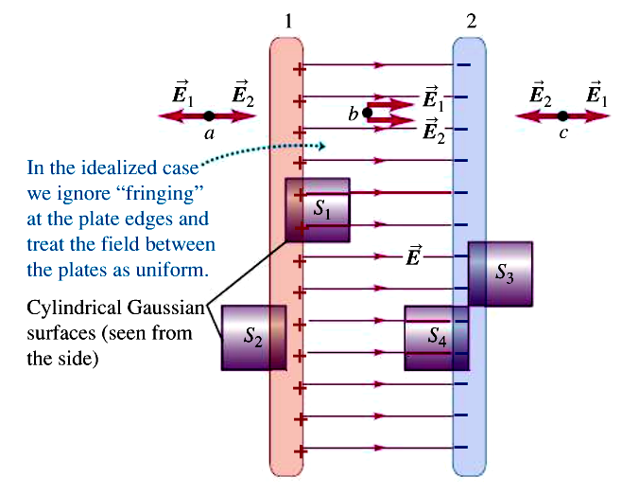

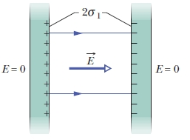

Two Uniform + charge conducting Plates

Slide 10
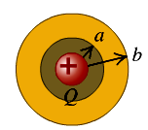
Problem 2
A conducting spherical shell with inner radius a and outer radius b has a positive point charge Q located at its center. The total charge on the shell is -3Q, and it is insulated from its surroundings.
Derive expressions for the E-field magnitude in terms of the distance r from the center for the regions r < a, a < r < b and r > b
What is the surface charge density on the inner surface of the conducting shell?
What is the surface charge density on the outer surface of the conducting shell?

Slide 11
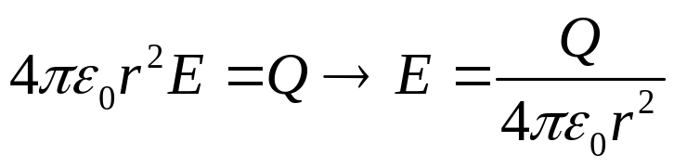
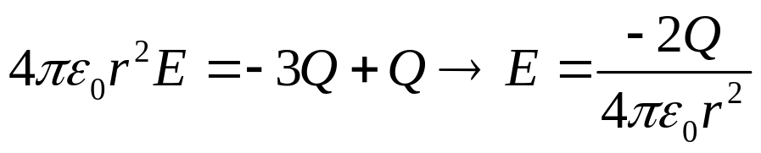
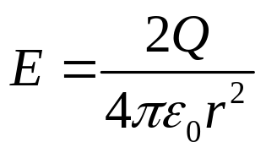
Problem 2
a spherical Gaussian surface with radius r
(a) r < a, Gauss’ law yields
(b) a < r < b , since these points are within the conducting material.
E=0
(c) r > b, Gauss’ law yields
The magnitude is:

Slide 12
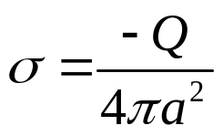
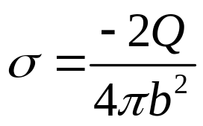
Problem 2
2. Since a Gaussian surface with radius r, for a<r<b, must enclose zero net charge, the total charge on the inner surface is –Q, so
3. Since the net charge on the shell is –3Q and there is –Q on the inner surface , there must be –2Q on the outer surface, so

Slide 13
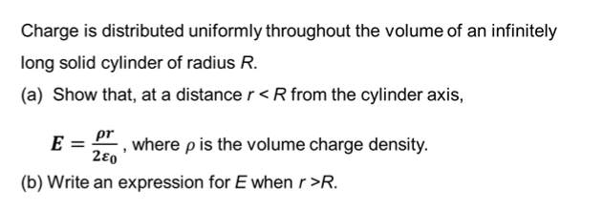
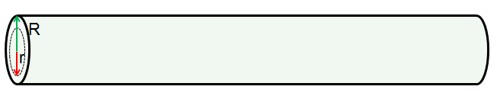
Problem 3

Slide 14
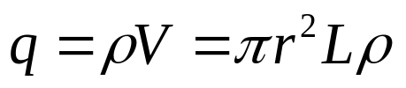

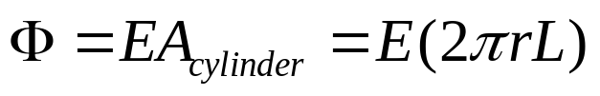
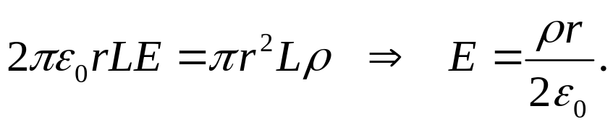
Problem 3
The Gaussian surface:
a cylinder with radius r and length L, coaxial with the charged cylinder.
The charge enclosed by it:
If is positive, the electric field lines are radially outward, normal to the Gaussian surface and distributed uniformly along it.
Gauss’ law leads to

Slide 15
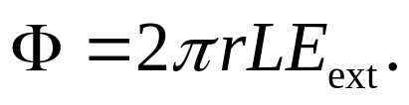
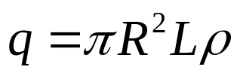
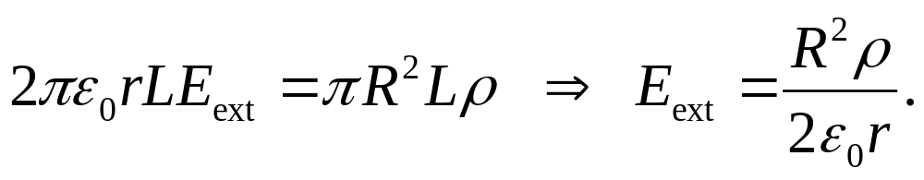
Problem 3
(b) We consider a cylindrical Gaussian surface of radius r > R.
If the external field is E_{ext} then the flux is
The charge enclosed is the total charge in a section of the charged cylinder with length L.
In this case, Gauss’ law yields

Slide 16
Problem 3
(c) Now, If this infinity long solid cylinder contains a cylindrical cavity of radius r₁ and the central axes of the cylinder and cavity are parallel. The distance between two axes is d = 2.00 cm, as shown in the figure. What is the electric field in the cavity? If the volume density does not change.
r₁
R
d
The cross section of the cylinder and cavity

Slide 17







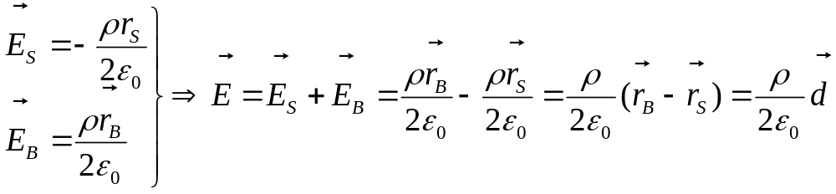
Problem 3
(c)
The total charge in the region of the cavity is zero, so:
For the small cylinder
For the big cylinder
For the cavity:
P
From (a), we know at point p in the cavity, the electrical field due to the small cylinder and big cylinder are:

Slide 18
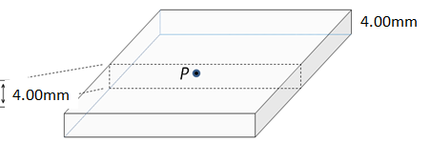
Problem 4
.
,
As shown in the figure, a square insulating slab 4.0 mm thick measuring 2.0 m × 2.0 m has a uniform volume charge density of ρ. Determine the magnitude of electric field as a function of z, both inside and outside (z<< 2.0m) the slab
z
y
2.00 mm
x

Slide 19
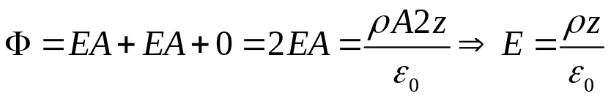
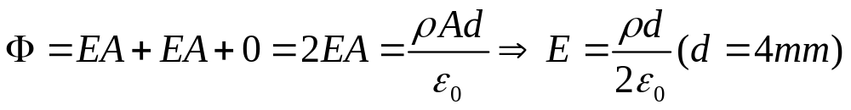
Problem 4
.
,
Inside the slab:
According to the planar symmetry, we can
Choose the Gaussian surface as in the figure
Shown:
z
Gaussian surface
outside the slab:
Side view of the slab

